Slide 1


Stock Price Prediction Using Machine Learning
Explore advanced models to forecast financial market trends and improve investment strategies.
by Yash Raj

Slide 2

Background: Importance of Stock Prediction
1
Critical for Investment
Stock prediction aids financial planning.
2
Challenges Volatility
Capture non-linear stock price patterns.
3
Need for Advanced Models
Leverage machine learning and time series.

Slide 3
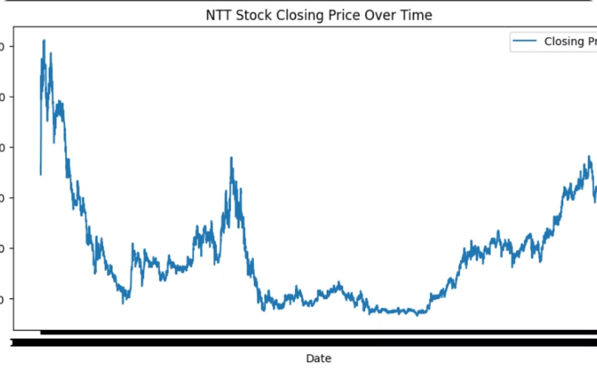

Data Preprocessing and EDA
Price Trend Analysis
Data Transformation
Revealed market corrections and volatility.
Handled large volumes and percentages.

Slide 4
Models and Feature Engineering
Model Approaches
Feature Engineering
Evaluation Metrics
Linear Regression, LSTM, ARIMA, SARIMA, Prophet, Chronos.
Moving averages, percentage changes, volume trends.
MSE, MAE, R² for model performance.

Slide 5

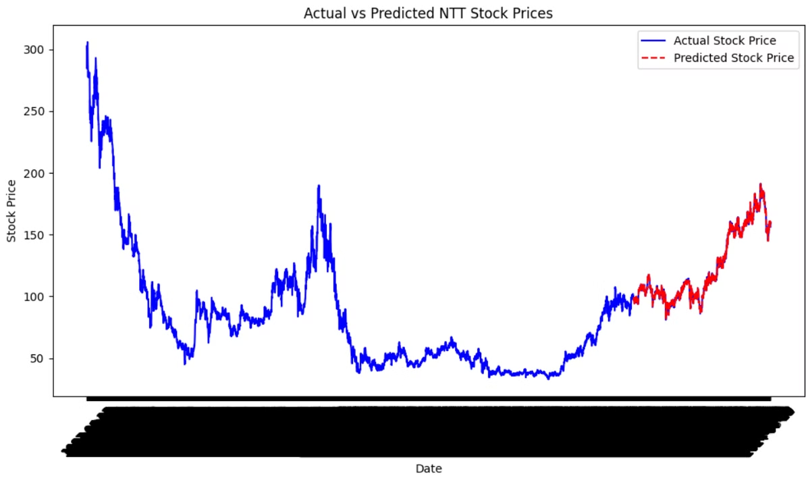
Linear Regression
Simple Baseline
Struggled with non-linear price patterns.
Near-Perfect Fit
But limited in real-world applicability.

Slide 6

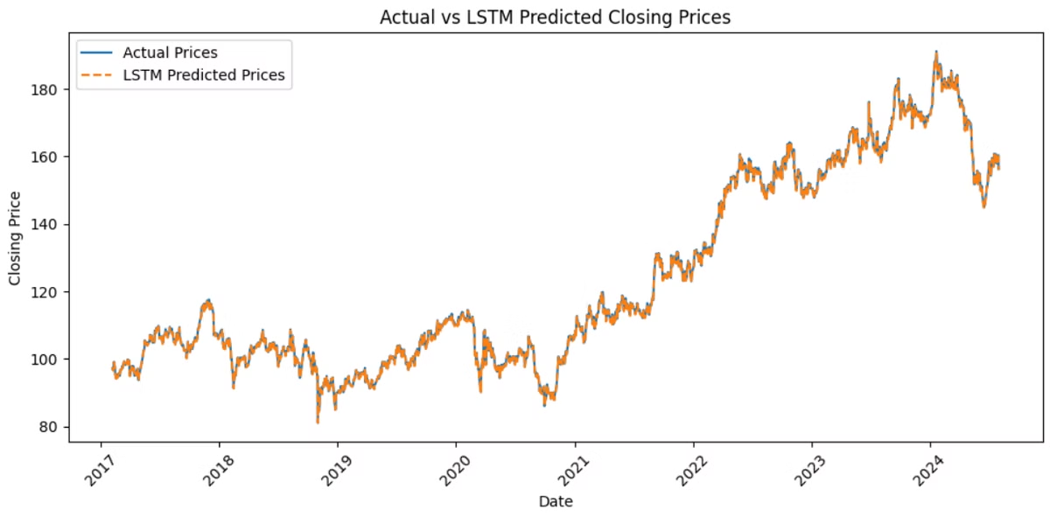
LSTM
1
Captures Dependencies
Handles short and long-term trends.
2
Improved Accuracy
Over linear regression but sensitive to hyperparameters.
3
Computational Complexity
Requires significant training time.

Slide 7

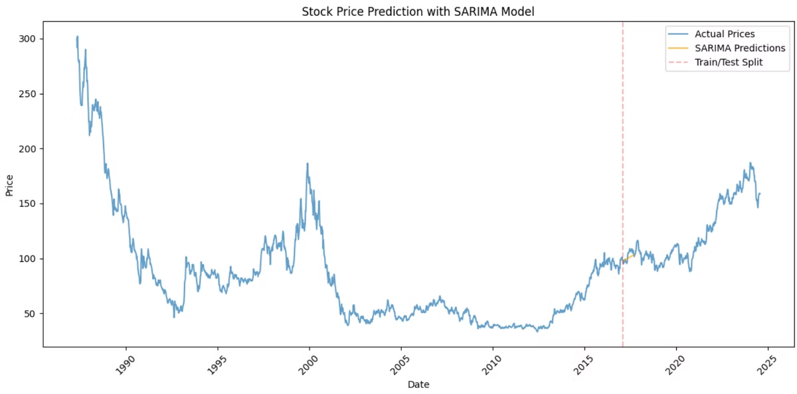
ARIMA and SARIMA
ARIMA Limitations
Struggles with non-stationary financial data.
SARIMA Improvement
Handles seasonality better but still lacks precision.

Slide 8
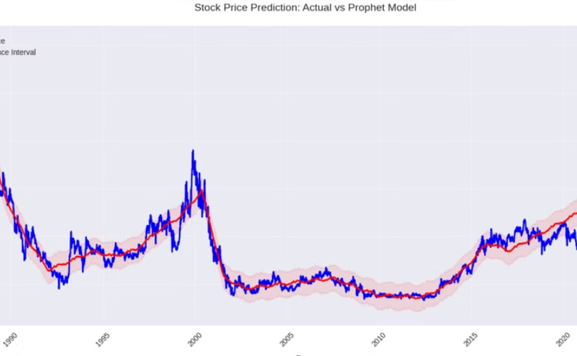
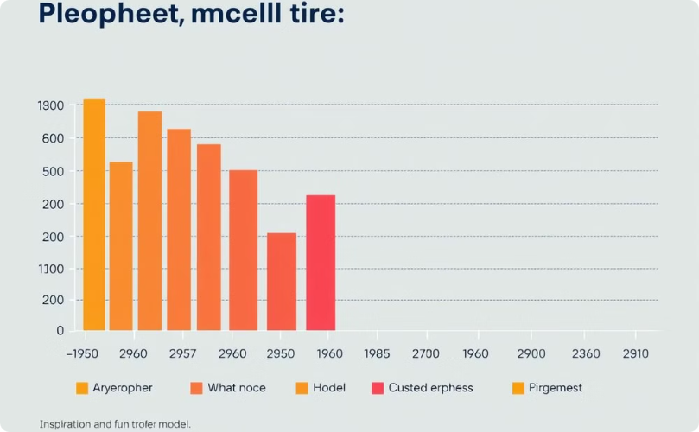
Prophet
Robust Forecasting
Evaluation Metrics
Captures trends and seasonality effectively. It also provides accurate predictions for future trends.
Performed well but lacked precision in volatility. Improved accuracy in long-term forecasts.

Slide 9

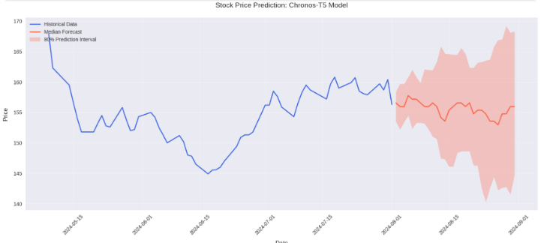



Chronos
Advanced Model
Deep Learning
Computational Cost
Excelled at handling complex patterns.
Provided the best overall performance.
Higher resource requirements than traditional models.

Slide 10




Hypotheses and Improvements
Moving Averages
Boosted performance for Prophet and Chronos.
LSTM Superiority
Outperformed traditional models in handling sequences.
Future Outlook
Explore ensemble models and incorporate external factors.

